Slide 1
Travel Insurance Claim Status
By :- Group – 03
Vivek Prajapat (19114019) Ashish Ubana (18114005) Saurabh Kumar Gupta (19114010) Pradnesh Lachake (19114007)
Supervised By :- Dr. Devlina Chatterjee

Slide 2
Introduction of Problem
Insurance companies take risks over customers. Risk management is a very important aspect of the insurance industry.
Insurers consider every quantifiable factor to develop profiles of high and low insurance risks. Insurers collect vast amounts of information about policyholders and analyze the data.
In this project we'll have to analyze the available data and predict whether the insurance is claimed or not using different machine learning classifier models.

Slide 3
Objective
The goal of this project is to determine if we can predict the claim status (Yes or No) from the various travel insurance-related attributes, such as Age, Duration of Travel, Destination of Travel, Amount of Sales of Travel Insurance Policies, etc.
This analysis will help to setup a new Travel Insurance company in competitive market based on various attributes.

Slide 4
Methodology
The methodology for this project is as follows:
Importing dataset, dataset inspection and data cleaning.
Data Exploration and Data Visualization.
Address categorical variables by using one-hot encoding, binning of age into child, adult, and senior.
Address imbalance in the data, Oversampling and Under sampling the dataset for training and testing.
Train a Probit and Logit model to do the prediction.
Compute Confusion Matrix and ROC Curve.

Slide 5
Economic Theory
The algorithms involve detection of relations between claims, detection of the missing observations, etc. In this way, the individual customer’s portfolio is made.
Forecasting the upcoming claims helps to charge competitive premiums that are not too high and not too low.
It also contributes to the improvement of the pricing models. This helps the insurance company to be one step ahead of its competitor.

Slide 6
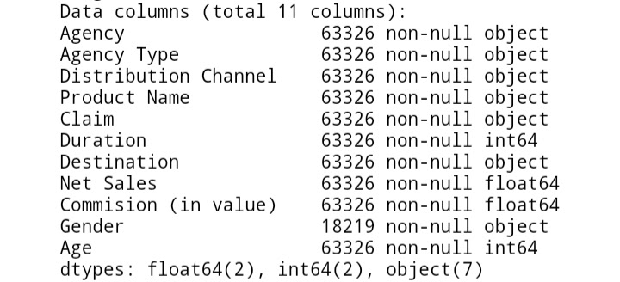
Description of Data
Data Source – The "Travel Insurance" data is provided by a third-party travel insurance servicing company based in Singapore.
Variables – The dependent variable is of object type is denoted by “Claim” in the data set which represents whether the insurance claim would be expected or not. There are 10 independent variables shown below.

Slide 7
Description of Data
Target: Claim Status (Claim. Status) – Yes, No
Name of agency (Agency) – LWC, TTW, CTB, etc.
Type of travel insurance agencies (Agency. Type) – Airlines, Travel
Distribution channel of travel insurance agencies (Distribution. Channel) – Online, Offline
Name of the travel insurance products (Product. Name) – Gold, Silver, etc.
Duration of travel (Duration) – in days
Destination of travel (Destination) - Location
Amount of sales of travel insurance policies (Net. Sales)
Commission received for travel insurance agency (Commission)
Gender of insured (Gender)
Age of insured (Age)

Slide 8
Sample Data
 | Agency | Agency Type | Distribution Channel | Product Name | Claim | Duration | Destination | Net Sales | Commision (in value) | Gender | Age
0 | CBH | Travel Agency | Offline | Comprehensive Plan | No | 186 | MALAYSIA | -29.0 | 9.57 | F | 81
1 | CBH | Travel Agency | Offline | Comprehensive Plan | No | 186 | MALAYSIA | -29.0 | 9.57 | F | 71
2 | CWT | Travel Agency | Online | Rental Vehicle Excess Insurance | No | 65 | AUSTRALIA | -49.5 | 29.70 | NaN | 32
3 | CWT | Travel Agency | Online | Rental Vehicle Excess Insurance | No | 60 | AUSTRALIA | -39.6 | 23.76 | NaN | 32
4 | CWT | Travel Agency | Online | Rental Vehicle Excess Insurance | No | 79 | ITALY | -19.8 | 11.88 | NaN | 41

Slide 9
Statistical Summary of Data
 | Duration | Net Sales | Commision (in value) | Age
count | 63326.000000 | 63326.000000 | 63326.000000 | 63326.000000
mean | 49.317074 | 40.702018 | 9.809992 | 39.969981
std | 101.791566 | 48.845637 | 19.804388 | 14.017010
min | -2.000000 | -389.000000 | 0.000000 | 0.000000
25% | 9.000000 | 18.000000 | 0.000000 | 35.000000
50% | 22.000000 | 26.530000 | 0.000000 | 36.000000
75% | 53.000000 | 48.000000 | 11.550000 | 43.000000
max | 4881.000000 | 810.000000 | 283.500000 | 118.000000

Slide 10
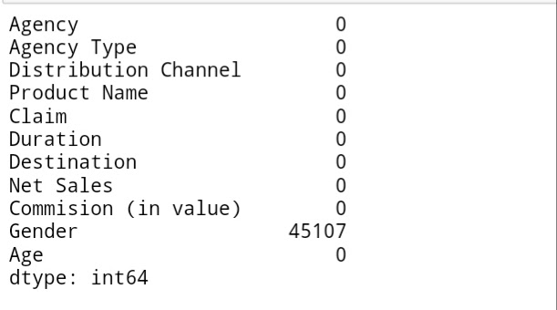
Missing Values
Gender column have 45107 missing values out of 63326 observations. So, we dropped this feature in analysis.

Slide 11
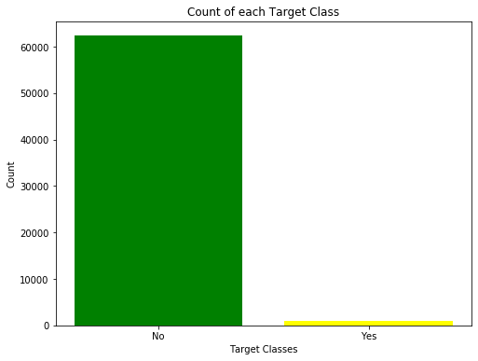
Distribution of Claim (Dependent Variable)
Claim
No 0.9854
Yes 0.0146
Our Data is highly imbalanced.

Slide 12
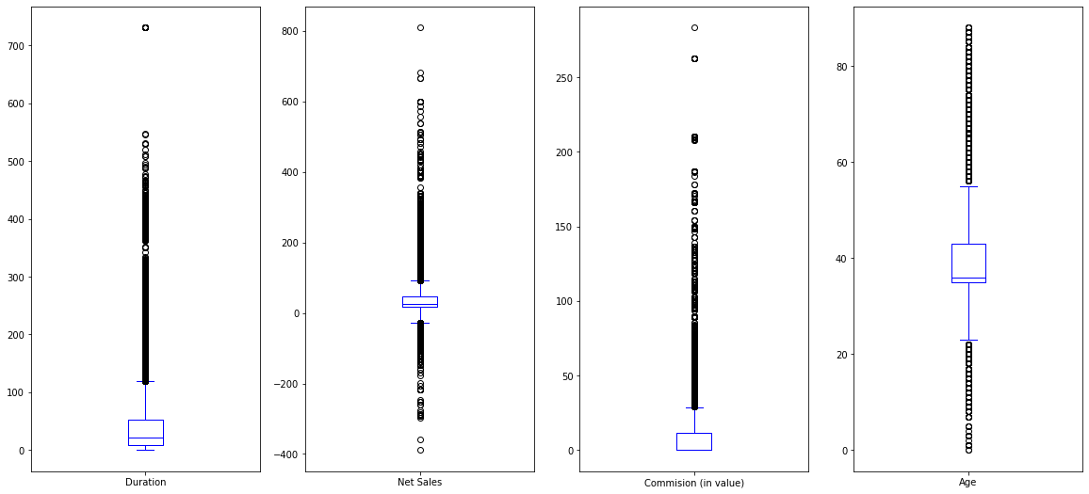
Box plots for Duration, Net Sales, Commission, and Age

Slide 13
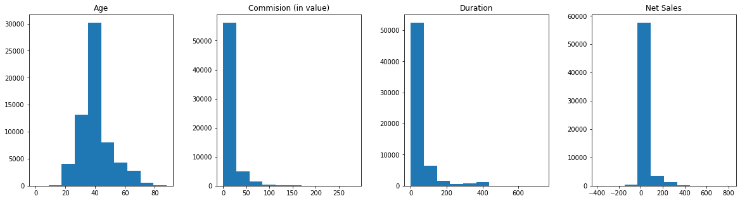
Histograms of Age, Commission, Duration, and Net Sales

Slide 14
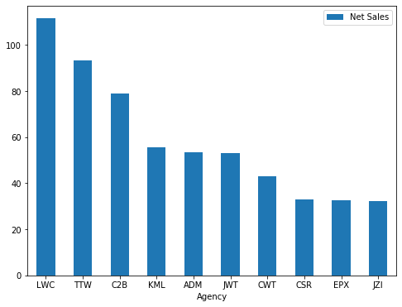
Travel Agency and their Net Sales

Slide 15
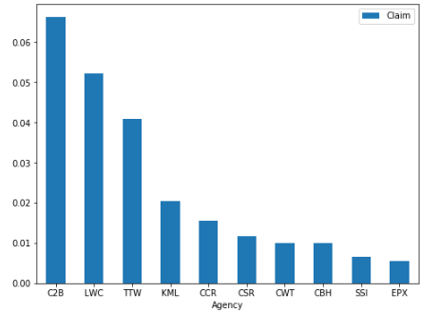
Plotting top 10 Agencies with the Maximum Claims

Slide 16
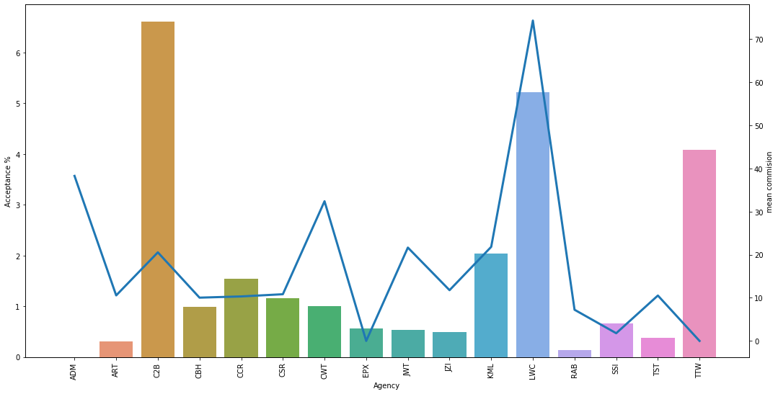
Plot between Travel Agency, Travel claim acceptance percentages, and mean commission
C2B company having mean commission is more than 70 and it’s claim acceptance percentage is around 2 percent.
CWT company having mean commission is less than 10 and claim acceptance percentage is more than 3 percent.
LWC company having mean commission is more than 50 and claim acceptance percentage is more than 6 percent.
TTW company having mean commission is more than 40 and claim acceptance percentage is less than 1 percent.

Slide 17
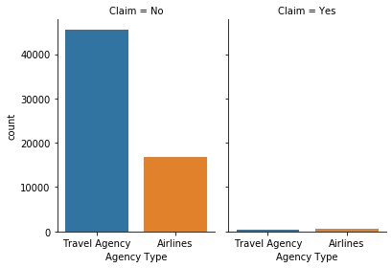
Claim and Agency Type
Agency
Claim | No | Yes
Agency Type
Airlines | 16866 | 591
Travel Agency | 45533 | 336

Slide 18
Check for Multicollinearity
Index | Features | VIF
2 | Distribution Channel | 9.64
0 | Agency | 8.08
5 | Net Sales | 5.45
3 | Product Name | 4.00
1 | Agency Type | 3.97
6 | Commision (in value) | 3.51
4 | Duration | 3.06
7 | Age Group | 1.25

Slide 19
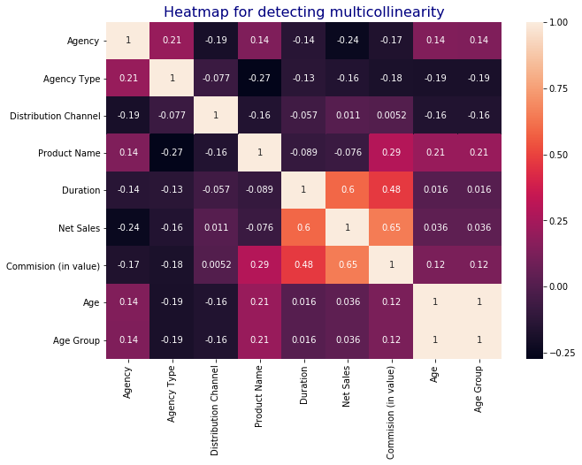
Correlation Matrix

Slide 20
Model 1 – Probit Regression
Z = - 0.755* 'DistributionChannel'- 0.4738* ‘AgencyType - 0.1131* 'Agency' -0.0802'Age Group' +0.0039* 'Net Sales' +0.0033* 'Commision (in value)' -0.0011* 'ProductName' -0.0004 'Duration’ + 0.4678 (const)
Prob(Claim = 1 / X) = Φ (Z)
Dep. Variable: | Claim | No. Observations: | 74399
Model: | Probit | Df Residuals: | 74390
Method: | MLE | Df Model: | 8
Date: | Sat, 13 Jun 2020 | Pseudo R-squ.: | 0.1850
Time: | 01:00:06 | Log-Likelihood: | -26790.
converged: | True | LL-Null: | -32870.
Covariance Type: | nonrobust | LLR p-value: | 0.000
Dep. Variable: | Claim | No. Observations: | 74399

Slide 21
Table
 | coef | std err | z | P>|z| | [0.025 | 0.975]
const | 0.4678 | 0.054 | 8.679 | 0.000 | 0.362 | 0.573
Agency | -0.1131 | 0.003 | -43.228 | 0.000 | -0.118 | -0.108
Agency Type | -0.4738 | 0.016 | -29.910 | 0.000 | -0.505 | -0.443
Distribution Channel | -0.7550 | 0.046 | -16.396 | 0.000 | -0.845 | -0.665
Product Name | -0.0011 | 0.001 | -0.939 | 0.348 | -0.003 | 0.001
Duration | -0.0004 | 9.76e-05 | -4.213 | 0.000 | -0.001 | -0.000
Net Sales | 0.0039 | 0.000 | 21.030 | 0.000 | 0.004 | 0.004
Commision (in value) | 0.0033 | 0.000 | 7.849 | 0.000 | 0.002 | 0.004
Age Group | -0.0802 | 0.009 | -9.021 | 0.000 | -0.098 | -0.063

Slide 22
Model 2: Logit Regression
Z = - 1.293* 'DistributionChannel' - 0.8496* ‘AgencyType - 0.2082* 'Agency' -0.1415* 'Age Group' + 0.0067* 'Net Sales' + 0.007* 'Commision (in value)' - 0.0039* 'ProductName' - 0.0013 'Duration’ + 0.9276 (const)
Prob(Claim = 1 / X) = F (Z)
F(z) = 1 / (1 + e^-z)
Dep. Variable: | Claim | No. Observations: | 74399
Model: | Logit | Df Residuals: | 74390
Method: | MLE | Df Model: | 8
Date: | Sat, 13 Jun 2020 | Pseudo R-squ.: | 0.1851
Time: | 01:00:07 | Log-Likelihood: | -26786.
converged: | True | LL-Null: | -32870.
Covariance Type: | nonrobust | LLR p-value: | 0.000

Slide 23
 | coef | std err | z | P>|z| | [0.025 | 0.975]
const | 0.9276 | 0.097 | 9.541 | 0.000 | 0.737 | 1.118
Agency | -0.2082 | 0.005 | -41.885 | 0.000 | -0.218 | -0.198
Agency Type | -0.8496 | 0.030 | -28.393 | 0.000 | -0.908 | -0.791
Distribution Channel | -1.2930 | 0.085 | -15.164 | 0.000 | -1.460 | -1.126
Product Name | -0.0039 | 0.002 | -1.731 | 0.083 | -0.008 | 0.001
Duration | -0.0013 | 0.000 | -6.837 | 0.000 | -0.002 | -0.001
Net Sales | 0.0067 | 0.000 | 19.025 | 0.000 | 0.006 | 0.007
Commision (in value) | 0.0070 | 0.001 | 9.077 | 0.000 | 0.005 | 0.009
Age Group | -0.1415 | 0.016 | -8.719 | 0.000 | -0.173 | -0.110
P- value of variable Product Name is greater than 0.05(critical value), which shows this variable is statistically insignificant.
So, we decided to drop this variable in further analysis.

Slide 24
Model3: Probit Regression
Z = - 0.7483* 'DistributionChannel'- 0.469* ‘AgencyType - 0.1134* 'Agency' -0.0808*'Age Group' + 0.0039* 'Net Sales' + 0.0031* 'Commision (in value)' -0.0004 'Duration’ + 0.4482 (const)
Prob(Claim = 1 / X) = Φ (Z)
Dep. Variable: | Claim | No. Observations: | 74399
Model: | Probit | Df Residuals: | 74391
Method: | MLE | Df Model: | 7
Date: | Sat, 13 Jun 2020 | Pseudo R-squ.: | 0.1850
Time: | 01:00:07 | Log-Likelihood: | -26790.
converged: | True | LL-Null: | -32870.
Covariance Type: | nonrobust | LLR p-value: | 0.000

Slide 25
Table
 | coef | std err | z | P>|z| | [0.025 | 0.975]
const | 0.4482 | 0.050 | 9.027 | 0.000 | 0.351 | 0.545
Agency | -0.1134 | 0.003 | -43.573 | 0.000 | -0.118 | -0.108
Agency Type | -0.4690 | 0.015 | -31.292 | 0.000 | -0.498 | -0.440
Distribution Channel | -0.7483 | 0.045 | -16.462 | 0.000 | -0.837 | -0.659
Duration | -0.0004 | 9.38e-05 | -4.115 | 0.000 | -0.001 | -0.000
Net Sales | 0.0039 | 0.000 | 22.030 | 0.000 | 0.004 | 0.004
Commision (in value) | 0.0031 | 0.000 | 8.360 | 0.000 | 0.002 | 0.004
Age Group | -0.0808 | 0.009 | -9.118 | 0.000 | -0.098 | -0.063

Slide 26
Model 4: Logit Regression
Z = - 1.2745* 'DistributionChannel' - 0.8346* ‘AgencyType - 0.2086* 'Agency' -0.1441* 'Age Group' + 0.0068* 'Net Sales' + 0.0064* 'Commision (in value)' - 0.0012* 'Duration’ + 0.8626 (const)
Prob(Claim = 1 / X) = F (Z)
F(z) = 1 / (1 + e^-z)
Dep. Variable: | Claim | No. Observations: | 74399
Model: | Logit | Df Residuals: | 74391
Method: | MLE | Df Model: | 7
Date: | Sat, 13 Jun 2020 | Pseudo R-squ.: | 0.1850
Time: | 01:00:08 | Log-Likelihood: | -26788.
converged: | True | LL-Null: | -32870.
Covariance Type: | nonrobust | LLR p-value: | 0.000

Slide 27
Table
 | coef | std err | z | P>|z| | [0.025 | 0.975]
const | 0.8626 | 0.090 | 9.627 | 0.000 | 0.687 | 1.038
Agency | -0.2086 | 0.005 | -42.122 | 0.000 | -0.218 | -0.199
Agency Type | -0.8346 | 0.029 | -29.173 | 0.000 | -0.891 | -0.779
Distribution Channel | -1.2745 | 0.084 | -15.088 | 0.000 | -1.440 | -1.109
Duration | -0.0012 | 0.000 | -6.632 | 0.000 | -0.002 | -0.001
Net Sales | 0.0068 | 0.000 | 19.853 | 0.000 | 0.006 | 0.008
Commision (in value) | 0.0064 | 0.001 | 9.248 | 0.000 | 0.005 | 0.008
Age Group | -0.1441 | 0.016 | -8.922 | 0.000 | -0.176 | -0.112

Slide 28
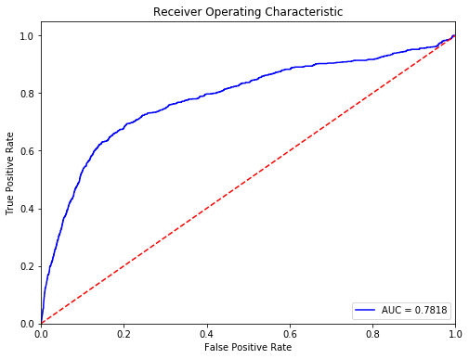
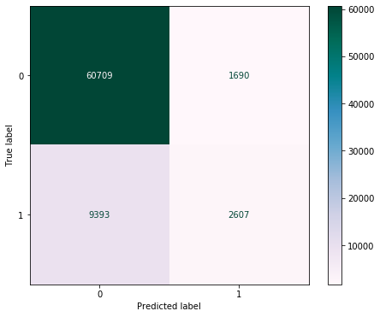
Confusion matrix and ROC curve for Model 2 (F1 Score = 0.8201574159740981)

Slide 29
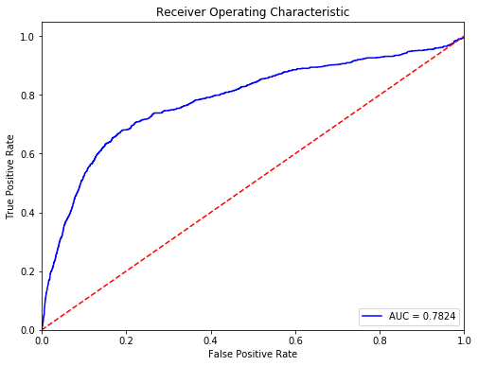

Confusion matrix and ROC curve for Model 4 (F1 Score = 0.8198684099306207)

Slide 30
Conclusion
From the exploratory data analysis we have found that our data is highly imbalanced, So we have used F1 score to check the model performance.
Both the classification models Probit and Logit have almost the same performance.
We have found ‘Product names’ is statistically insignificant.
From the final model following are the features listed in their decreasing order of their significance
'DistributionChannel'
‘AgencyType’
'Agency'
'Age Group'
'Net Sales'
'Commision (in value)''Duration’

Slide 31
Omitted Variable Bias
Medical History
Purpose of Travelling (Adventure Sports, etc)
Any formal proofs of stolen personal belonging.
Consumption of Alcohol and any other stuff.

Slide 32
Thank You

